Slide 1
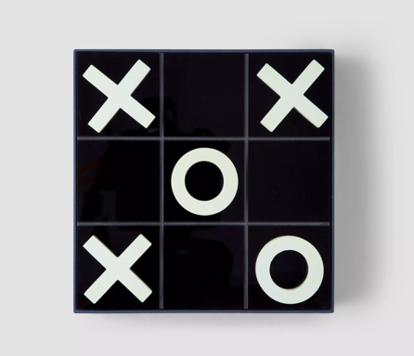

TIC-TAC-TOE
PROJECT 1
Group Presentation
Nesma Dehili
Sarah Leouffre
Nadim Saad
Date: Monday Dec. 6th 2021

Slide 2


Description of
the Game
We all have fond memories of playing Tic-Tac-Toe with our friends in school, don’t we?
It is one of the most fun games you can play anywhere!

Slide 3

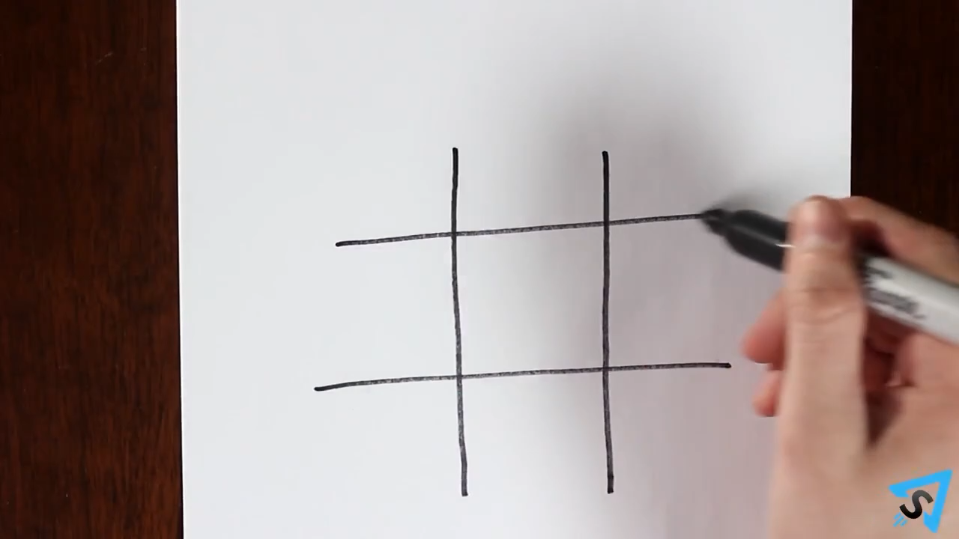

Game Challenges
01
2 players can play Tic-Tac-Toe at a time
The players create a 3×3 square grid
While the first player puts “X” in any one of the squares, and the second player will put an “O” in any square.
2021

Slide 4
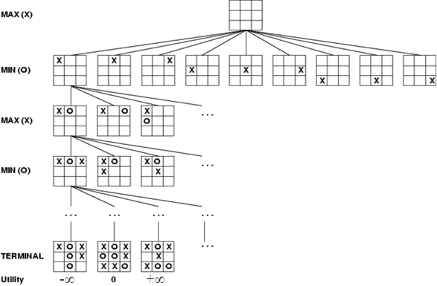
Game Process
02
The game continue until all the squares are filled with each player putting X and O alternatively.
The player who succeeds in creating a horizontal, vertical, or diagonal with three consecutive X or O on the grid wins.
Our goal here is to:
Build this project on Python.

Slide 5
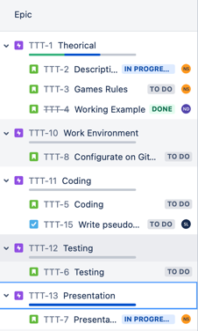
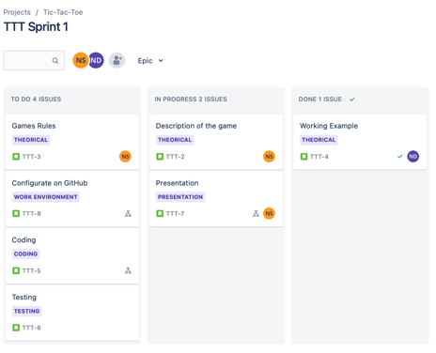

What we did on Jira
Notes:
Source File;
https://unsplash.com/photos/EhTcC9sYXsw

Slide 6
Game
Highlights
03
Explain how the game goes in Python i.e. talk about how we need to check if player X or O has won, for every move after 5 moves

Slide 7
Game Demo
04
Here we need to talk about how the game goes on Python

Slide 8
Questions & Answers

Slide 9

THANK YOU!

